Slide 1
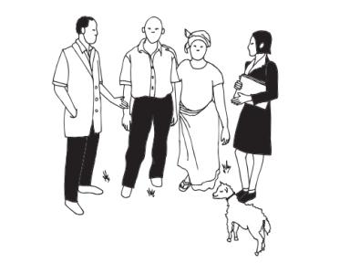
Choosing the level of randomization

Slide 2

Unit of Randomization: Individual?

Slide 3
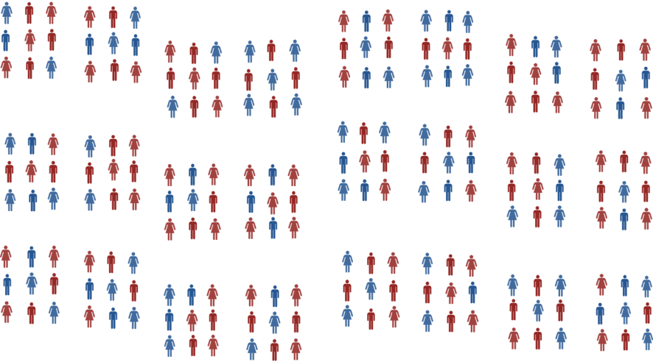
Unit of Randomization: Individual?

Slide 4
Unit of Randomization: Cluster?

Slide 5
Unit of Randomization: Cluster?

Slide 6
Unit of Randomization: Class?

Slide 7
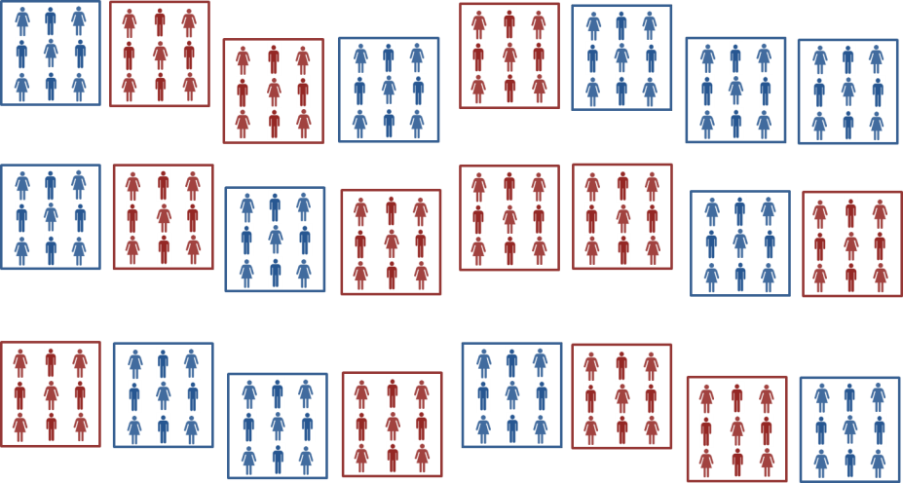
Unit of Randomization: Class?

Slide 8
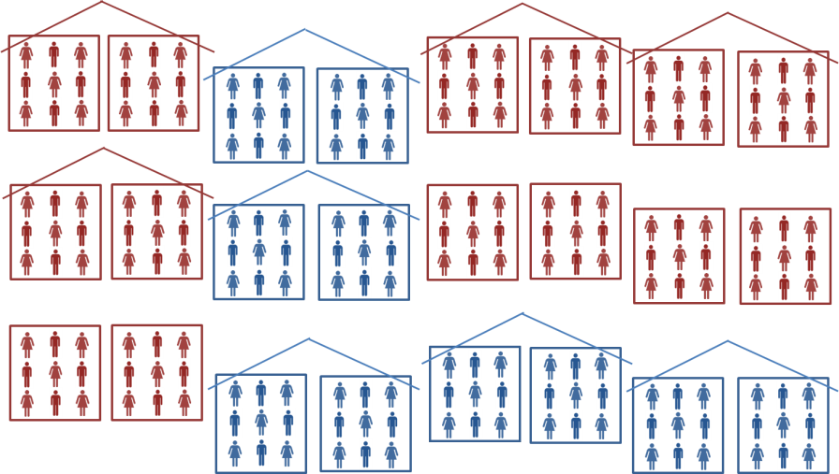
Unit of Randomization: School?

Slide 9
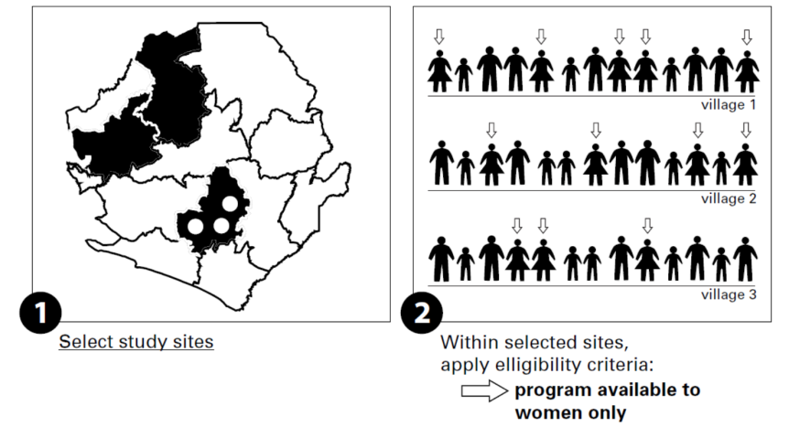
Steps in individual level randomization

Slide 10
Steps in individual level randomization

Slide 11
Steps in group level randomization
large villages only

Slide 12
Steps in group level randomization

Slide 13
Considerations for level of randomization
Unit of measurement
Feasibility and fairness
Spillovers
Attrition
Compliance
Statistical power
Clustering on the ground

Slide 14
Measurement and unit of randomization
Randomization cannot take place at a lower level than our outcome is measured
Outcome is quality of school building, cant randomize at level of class, teacher, or child
Outcome is election of MP from a minority group, cant randomize at level lower than MP constituency
Note if our outcome is self reported voting for a minority candidate then can randomize individually

Slide 15
Feasibility and unit of randomization
Usually randomization is at the level at which the program is implemented
Community health program is randomized by community
School improvement program is randomized by school
Randomizing below this level means changing how program implemented
  Eg nutritional supplement program normally done by school but randomized by individual has to keep track of which children are treatment, adding to cost of program

Slide 16
Political feasibility and perceived fairness
Randomizing at a higher level can make randomization be perceived as fair
Important to understand what is seen as fair in a given context
It may seem fair that some schools are selected for a pilot program, if schools have a fair (random) chance of being selected for the pilot
Providing some individual students with a program and excluding others within a school may be seen as less fair

Slide 17
Spillovers
When a program changes outcomes for those not directly participating we call this impacts “spillovers”
Physical spillovers
  a farmer draws water from an aquifer and there is less for others (negative spillover)
Behavioral spillovers
  if some children go to school more this may encourage others to go (positive spillover)
Informational
  if one mother learns the benefits of breastfeeding she may tell her friends (positive spillover)
Market or general equilibrium
  If some firms reduce cost of production and price this may affect the price other firms can charge for their product (negative spillover)

Slide 18
Spillovers and randomization unit
Spillovers mean outcomes for the comparison groups may be impacted by the program
The comparison group is no longer a good counterfactual
Q: if positive benefits of the program spillover to the comparison group, will this lead to an under or over estimate of program impact?

Slide 19
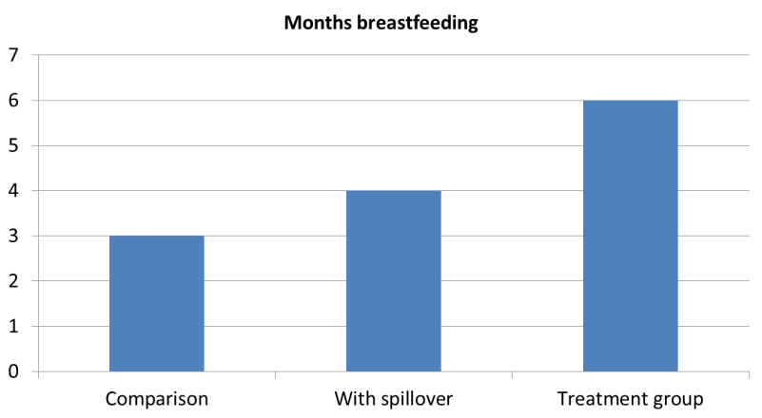
Positive spillover bias
measured
impact
true
Impact
bias
Measured impact = 2 months
True impact = 3 months
Bias = Measured impact – True impact = - 1 month

Slide 20
Containing spillovers within treatment group
Containing spillovers by randomizing at a higher level
Child given free meal at school will share with friends
treatment
comparison
spillover

Slide 21
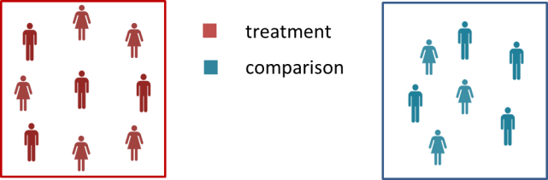
Containing spillovers within treatment group
Containing spillovers by randomizing at a higher level
Child given free meal at school will share with friends
Randomizing at level of school solves the problem

Slide 22
Creating a buffer to absorb spillovers
We can randomize at the individual level if our sample individuals are far enough apart to avoid spillovers
Farmers given new variety of rice, sample farmers live far from each other. Live on their farms so no obvious “community” to randomize by
Not sampled

Slide 23
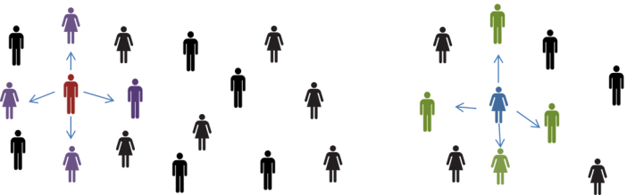
A design to measure spillovers
We can randomize at a level where some of the comparison experience spillovers and some don’t
In our farmer example, farmers near treatment farmers are spillover farmers, and can be compared to those near comparison farmers
In this example we asses spillovers by comparing purple figures with green figures

Slide 24
Example: deworming
If a child is dewormed they are less likely to infect children in the neighborhood
While most of the spillovers would occur within schools, but some children lived near those who went to neighboring schools
Miguel and Kremer (2004) randomized at the school level but also measured outcomes in near by schools

Slide 25
Attrition and unit of randomization
Attrition is when we cannot collect data on all our sample
Usually attrition occurs when people move or are not at home when enumerators call
If people feel a study is unfair they can refuse to cooperate, leading to attrition
Sometimes providing benefits to some but not their neighbors is seen as unfair and can cause attrition
It is important that randomization is seen as fair for many reasons, reducing attrition is one of them
Randomizing at a higher level can help

Slide 26
Compliance and unit of randomization
Full compliance is when all those in the treatment group get the program and all those in the comparison don’t get it
Low level randomization may lead to sharing which undermines compliance
Example: iron supplements in Indonesia
  Iron supplements aimed at older people
  Only providing supplements to some in the family might lead to sharing with others, diluting effect
  Providing supplements to everyone in the family increased compliance
Source: Thomas et al, 2006.

Slide 27
Compliance and unit of randomization
Simple to implement designs achieve higher compliance
Avoid having one person implement two versions of a program
Example: adding health insurance to micro credit
  One microcredit officer serves 10 groups in an area
  If randomize some groups to be offered health insurance and some not, credit officer will need to keep straight who can apply for insurance and who cant
  May need to randomize at the credit officer level

Slide 28
Power and unit of randomization
Statistical power is the ability to detect an effect of a given size
Individual randomization gives more power than group randomization (for a given sample size)
We get more information from 20 children individually randomized than from 20 children in two schools (one treatment and one comparison)
We will return to this subject in much more detail
Many factors push as to randomize at higher levels, power pushes us to randomize lower

Slide 29
Power and unit of randomization
Clusters by which we randomize must make sense on the ground
Administrative boundaries do not always correspond to how people interact with each other
People may cluster and interact in smaller groups than administrative neighborhoods or villages
  We can randomize by these natural neighborhoods and have more power than if we randomized by administrative neighborhood
Or administrative neighborhoods may blend into each other with little real difference evident on the ground
  Risk that implementers may not know who is in treatment and who in comparison

Slide 30
Example: hamlets vs. villages in India
Rural areas in India are divided into villages or panchayats, but in much of India a lot of social interaction happens within a hamlet
Some interventions can be randomized by hamlet
Hamlets
Villages

Slide 31
Example: farmers in Western Kenya
In some parts of Kenya people live on their farms and randomizing by administrative “village” may make little sense
Some researchers have randomized farming programs by which school households send their children to as this may represent a more natural locus of interaction (Duflo, Kremer, and Robinson 2007)
Villages
Schools
School-related clusters

