Slide 1
Evaluation start-to-finish Impact of Microcredit
Module 1.2

Slide 2
Overview of lecture and course
Why randomization was useful for evaluating impact
Finding the right question, partner, and location
Introducing randomization into program roll out
Measuring outcomes
Calculating sample size
Threats to the integrity of the evaluation
Analysis
Policy influence
Time line

Slide 3
Different types of evaluation When and where to randomize
Chapters 2 and 3

Slide 4
Evaluating microcredit
Many important questions to ask about microcredit
Only some of them are impact questions
What is the need that microcredit might be filling?
From whom and how much and at what rates do those without access to microcredit borrow at?
How many people borrow from microcredit organizations?

Slide 5
Process evaluation questions for microcredit
What proportion of people in an area where microcredit is available borrow from microcredit groups?
What is the repayment rate of loans?
What proportion of microcredit clients expand their business enough to employ another person after 5 years?
How many microcredit borrowers still borrow from other sources
Why do those who borrow from other sources say they continue to borrow from these sources?
What is the cost of administering microcredit loans as a proportion of the money lent out?

Slide 6
Measuring impact of microcredit is hard
Compare outcomes for women who do and don’t sign up for microcredit in communities where microcredit is available?
Those who sign up are different from those that don’t
Compare women in areas where there is microcredit with those in areas without microcredit?
But microcredit organizations go to the areas where there are most business opportunities and people want to borrow
Compare women before and after they sign up for microcredit?
Economy may be growing and outcomes improving for everyone
A woman may take a loan when she starts a business but may still have started a business with the loan

Slide 7
Randomization for evaluating impact
Randomizing who has access to microcredit helps disentangle the impact of microcredit from other factors,
like motivation
business opportunity growth
Randomization creates two groups, treatment and comparison who (on average) are the same on all characteristics
Observable characteristics like income
Unobservable characteristics like motivation and entrepreneurial ability

Slide 8
RCT of microcredit impact was a priority
Microcredit was a large and expanding program
Existing studies of impact compared women with and without access to microcredit
Concern that women with and without access were not comparable and thus existing measures of impact were biased
Took many years to find the right opportunity to evaluate the impact of microcredit

Slide 9
Finding the right partner
Evaluation of a representative microcredit program would be particularly valuable
Many different variants of microcredit programs
However, a large majority of programs had a similar structure of lending small amounts of money to groups of women with weekly repayment schedules
Partner needed to be very committed to evaluation
It was going to be hard to ensure that loans were only offered in treatment areas
Leadership needed to be willing to forgo opportunities for expansion for the sake of evaluation
Need location with potential for large sample size

Slide 10
Finding the right partner: Spandana
Launched in 1998, 16,400 clients by 2002
Meant evaluation was of a mature program
Standard lending model
Mainly group lending of small but rising amounts to women borrowers
For profit (not standard) and less focused on changing norms than some organizations
Moving into a new city
Room for large sample size
Very committed head in Padmaja Reddy

Slide 11
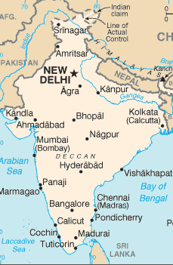
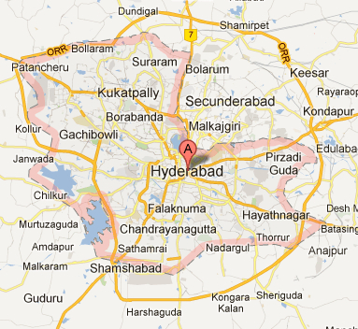
Setting: Hyderabad, India
Hyderabad

Slide 12
Descriptive assessment of setting
The city
1/3 of Hyderabad’s population lives in slums
In 2004, no MFIs were working in these neighborhoods
Yet 69% of households had an informal loan
Households in target areas
Avg. expenditure, per person per month: Rs. 981 ($18)
Avg. debt : Rs. 36,567 ($670)
Literacy rate: 68%
Businesses per person: 30%
Enrolled or finished studies? 29%

Slide 13
What level to randomize at?
Client
Client
Client
Client
Client
Client
Client
Client
Borrowing group
Community
(branch office)
Notes:
Loans are joint-liability at the group level. They also offer an individual-liability loan (you can graduate up to it, I think) – and men are allowed that one too. Very few clients have that.

Slide 14
Unit to randomization options
Could not randomize by individual
Spandana lent to groups not individuals
What unit of randomization makes sense?
client? group? credit officer? center/branch office?
wanted impact on community, including spillovers
Could not randomize by borrowing group
Who is the borrowing group in comparison areas?
Interested in the impact of access to microcredit on the community
Nonborrowers might gain by being employed by borrowers
Existing businesses might loose from additional competition from new businesses
Decided to randomize access by communit

Slide 15
Research design
Spandana reviewed neighborhoods for suitability
selected 120 originally but dropped 16 because mostly migrants
Encouraging Spandana to choose more communities would increase our sample size, but if they chose communities that were not suitable and take up was low this would reduce the power of the experiment
Eventually 104 neighborhoods: 52 treatment, 52 control
Spandana wanted to get started but reviewing all the neighborhoods was slow process
Waited till a group of neighborhoods had been reviewed for suitability by Spandana, then randomized within the group
Created matched pairs of similar neighborhoods, then randomized within the pair (one to treatment and one to comparison)

Slide 16
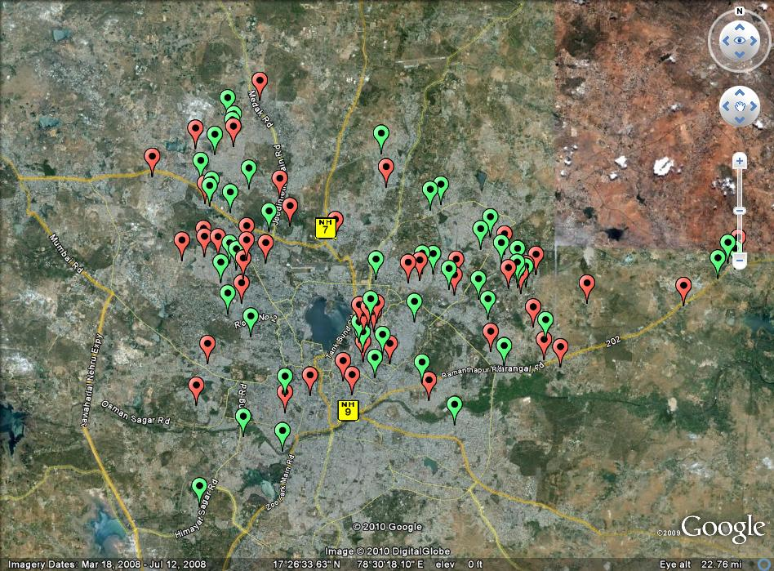
Treatment and comparison areas

Slide 17
Final research design
52 Treatment slums
Spandana
(+ others)
104 neighborhoods
52 Comparison slums
Only others
Baseline Survey
Endline Survey
R
Monitoring of Intervention

Slide 18
Measurement
Chapter 5

Slide 19
Research questions
Conversations with Spandana, generated following questions:
What happens when you offer microcredit?
What’s the take-up?
Does household expenditure change?
Are new businesses created? Do existing businesses make more profits?
Does access to microcredit impact education? Expenditure on health? Female empowerment?

Slide 20
Measurement and theory of change
In designing measurement strategy, researchers considered three alternative theories of change
Microcredit helped women create or expand businesses
Microcredit helped women save for durable goods
Microcredit allowed women to increase consumption temporarily without increasing income
Each step in each theory of change was mapped to an indicator on which data were collected

Slide 21
Theory of change: Entrepreneurship
Higher Income
Have entrepreneurial skills
Investment (in a business, or not?)
Get a microloan
Main constraint on business investment: lack of credit
Nearby Spandana branch
Eligible for a loan
Apply for a loan
Women’s empowerment
Women are financially dependent
Women use the loan
Increased competition for existing businesses
Increased local employment
Health and education spending
Start a new business

Slide 22
Theory of change: Savings
Reduced expenditure on “temptation” goods
Investment (in a business, or not?)
Get a microloan
Main constraint on investment: inability to save
Nearby Spandana branch
Avoid shocks
Eligible for a loan
Apply for a loan
Women’s empowerment
Women are financially dependent
Women use the loan
Loan acts as a commitment device
Higher income

Slide 23
Theory of change: Consumption
Get a microloan
People are easily tempted into debt
Nearby Spandana branch
Eligible for a loan
Apply for a loan
Lower income (long run)
Increased consumption
Debt trap
No increase in investment
No reduction in high-cost debt (no refinancing)

Slide 24
Log Frame
 | Objectives Hierarchy | Indicators | Sources of Verification | Assumptions / Threats
Impact (Goal/ Overall objective) | Higher income | Spending | Household survey | Poor access to credit prevents households from investing in business or assets
Outcome (Project Objective) | Households start new businesses; expand existing ones | Purchase of durable goods | Household survey | No problems of self-control, no time-inconsistency
Outputs | Increased MFI borrowing | Number of microloans | Household survey, Administrative data from MFIs | No borrowing from informal sources
Inputs (Activities) | MFI branches are opened | Branches are operating; providing services | Branch visits/ surveys | Sufficient resources, funding, manpower

Slide 25
Measurement
Indicator | Instrument | Source
Investment | Number of businesses per household; business size; duration; costs and revenue; sales | Household questionnaire: Household member module Business module Loan module Health event module
Consumption | Monthly expenditures of the household, itemized; “Special” spending (e.g. weddings)
Women’s empowerment | Decision-making by household members
Health and education | Number of health events; tuition spending; education completed of all household members

Slide 26
Challenges in measurement
People mix household and business accounts and do not have a good idea of their profits
Solution: walk people through recent revenue and expenditures and help them calculate profits
Not accurate recall on loans
Many households we knew were Spandana borrowers reported having now loans from microcredit organizations
Did they think if they said they had no loans they could get more loans?
Solution: did not rely on reported loans too much in analysis
How to measure social outcomes and empowerment?
Chose to focus on expenditures on education and health
Measured decision making by women over expenditure in different areas (more empowerment if more control over spending)

Slide 27
Who to interview?
Cannot only interview Spandana borrowers
Who would be interviewed in the comparison areas
Interview those who are likely to be borrowers or who would benefit or loose from arrival of microcredit
Criteria for borrowing from Spandana useful screen for being part of the survey
Female
18-59 years old
Residing in the same area for >1 year
Valid ID/residential proof
>80% of women in a self-formed group must own their own home

Slide 28
Baseline survey (2004)
n = 2,800 households
120 neighborhoods identified by Spandana
HHs randomly selected – must have >1 eligible client (18-59 y.o. woman)
Decided not to census all households in communities
Survey company went to the center of community and picked every other house to survey
This was a mistake
Ended up with overrepresentation of HH near center of slum
Q: how might those near the center be different from others?
Q: in what ways might this effect the validity of the evaluation?
Before endline carried out census to get list of all eligible HH and then chose randomly from there which HH to survey
Notes:
These slums were selected based on having residents who were desirable potential borrowers: poor, but not “the poorest of the poor.”

Slide 29
Sample size and statistical power
Chapter 6

Slide 30
Factors for calculation sample size
How big an impact did the researchers want to be able to detect?
What was take up of microcredit likely to be?
The higher take up, the bigger the impact on the community, the smaller the sample size
Most important: how many communities to randomize?
Limited by the number of communities Spandana thought were suitable for microcredit
Little point in expanding into nonsuitable communities as this would just reduce take up
How many households to survey per community?
Given limit on number of communities, researchers had to interview a lot of households per community
Given the correlation in outcomes within communities (some were richer than others) this meant researchers got little extra power for each additional HH interviewed

Slide 31
Threats to the validity of the experiment
Chapter 7

Slide 32
Threats and response to threats
Invasion of controls
Incentivized credit offices went into comparison neighborhoods
Other MFIs expanded operations rapidly in treatment and comparison neighborhoods
Low take up
Undertook special surveys to measure take up

Slide 33
Threats and response to threats
Invasion of controls
Incentivized credit offices went into comparison neighborhoods
Other MFIs expanded operations rapidly in treatment and comparison neighborhoods
Low take up
Undertook special surveys to measure take up
Worked with Spandana to restrict their credit officers from entering comparison groups
Timing—take up rising in treatment and comparison
Should we encourage more take up? No
Over sample borrowers? No
Massively increase sample at endline of those likely to borrow. Came with some costs.

Slide 34
The problem of take-up
80%
Take-up (according to Spandana)
50%-60%
Researchers estimate of take up
27%
Actual take-up (any MFI)
Take-up in comparison group
18.7%
NB: take up numbers from endline (2007) not followup

Slide 35
Endline survey (2007-2008)
Endline survey had to make up for two errors
Initial baseline did not cover representative clients
Solution: do a census of eligible HH and choose those to be interviewed randomly
Take up was lower in treatment and higher in comparison than expected
Did not introduce bias into the estimate
Did reduce power to pick up modest effects
Solution: interview many more households
n = 6,800 households
In same 120 neighborhoods
Meant did not have baseline characteristics on most of the sample
Did collect data on characteristics that would not have changed like date of birth
This allowed us to do subsample analysis as discussed below
Notes:
Question from Rachel: [am I right that we basically interviewed every hh that had certain characteristics, ie likely to borrow? Or was it that could borrow?]
Answer from Angela: I’m not 100% sure, but I think it was every HH that had an eligible potential client (a woman between 19 and 55)

Slide 36
Analysis
Chapter 8

Slide 37
Analysis: Intention to Treat
Intention to treat analysis
Measured the impact on hh who had women who were eligible for the program (target of survey)
Correction for group level randomization
Take up in the comparison group was 18.7%
Take up in the treatment group was 27%
Ie a difference of 8%
Results show the benefits of having 8 percent more take up of microcredit

Slide 38
Additional analysis
Despite problems with compliance, did not attempt to measure impact on compliers
Interested in the community level effect
Access to credit might have spillovers to those who did not take it up, so measuring impact on compliers would not have been appropriate
Sub group analysis: assessed impact separately for:
Those who already owned a business
Those with baseline characteristics associated with starting a new business
Those with baseline characteristics associated with not starting a new business
In each case compare those in treatment and comparison with these characteristics

Slide 39
Results: Businesses
Overall take-up of loans: 27% (vs. 18.7%)
30% of loans were used to start new businesses
22% to buy stock for existing businesses
impact
Percent of households operating a new business.
Notes:
“new” = opened <1 year ago

Slide 40
Results: Spending
HHs with existing businesses
bought more durable goods
Were not hurt by competition from new businesses
HHs likely to start a business
cut back on temptation goods (tobacco, eating out)
and invested more
HHs unlikely to start a business
Spent more on non-durable consumption
No change in health, education, empowerment

Slide 41
Policy influence
Chapter 9

Slide 42
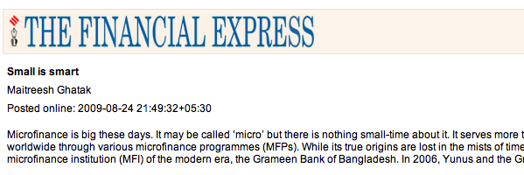
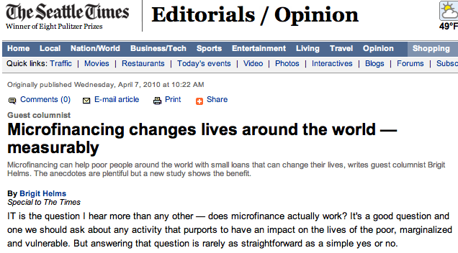
Evaluation results made waves
Notes:
There were a number of media responses to the study, most notably Brigit Helms – CEO of Unitus (representing several MFIs and social enterprises) – who challenged the study findings in her Seattle Times op-ed. Abhijit, Esther and Dean Karlan responded with a New York Times column.

Slide 43
Press reaction to the results
Even before researchers actively disseminated results, press picked up on working paper
Q: why was dissemination of results so quick in this case?
Most press reaction stressed that the evaluation showed microcredit did not work
Q: why do you think the press had this reaction?
Q: do you think this is a valid interpretation of the results?

Slide 44
Microcredit organization reaction
Reactions from microcredit organizations was mixed
Reaction 1: we always knew microcredit was primarily a financial product. These results show that it helps create businesses and boost investment
Reaction 2: this is a bad study which proves nothing
Its just one organization in one location, others work
The time frame is too short, empowerment effects work over a longer time frame than 18 months
Researcher response
Attempt to extend timeline of study (although take up in comparison areas made this hard to do well)
Other researchers tested microcredit impact in very different environments and found similar results (eg Karlan and Zinman, Desai et al, Anglucci et al, Desin et al)

