Slide 1
The Practicalities of Running Randomized Trials: Lecture 12: Analysis
Rachel Glennerster

Slide 2
Overview
Prior to analysis
The basic structure of RCT analysis
Comparing means vs other moments
Adjusting analysis for:
Clustered level randomization
Noncompliance
Low take up
Defiers
Spillovers
Attrition [next lecture]

Slide 3
Initial data checks
Prior to analysis there is quite a lot of work to do to “clean” data to get it ready
Turning categorical variables into dummies (eg religion, gender, where 888 is don’t know etc)
Inconsistencies—eg 99 year olds giving birth
Comparing back check data to initial surveys
Responses outside feasible range—200 year olds, child height 2cm, farm size is negative etc
Correct only when absolutely sure—don’t “over clean”
Check for outliers
Check attrition rates—you may end up going back to collect more data
Plot and describe the data, allows you to check for
Outliers
Bunching
Geolocations in the wrong country etc

Slide 4
Intention to treat estimate: individual randomization
$Y_{i}$ = α $+ βT_{i}$ $+γ X_{i }+ε_{i}$
$Y_{i}$ is outcome for individual i
α is the mean of the control group
$β$ is the coefficient (impact) we are estimating
$T_{i}$ is a dummy that takes the value 1 if an individual is randomized into treatment
$X_{i }$is a set of control variables for each individual i (common to report but with and without covariates)
$ε_{i}$ is the error term
Q: what does the ITT coefficient measure?
The difference in means between those randomized to T vs C
ie impact of being allocated to T, not of getting the treatment, often this is the policy relevant question
ITT measures impact of treatment of those whose behavior changes as a result of treatment (compliers)

Slide 5
Which covariates to include?
Adding covariates that reduce unexplained variance will increase the precision of our estimate of $β$
Only covariates that were collected at baseline, or are invariant over time can be used
Usually, adding covariates either does nothing or reduces standard errors. If it leads to radical changes in the estimate of $β$ its worth checking what is going on:
Often cause is there are missing values for a variable so adding it as a covariate leads to dropping a lot of data, or certain kinds of people
Eg including as a covariable a variable that is only available for those who are married means estimating the effect only on married people, where impact might be different
Was there imbalance at baseline on this variable?
But adding “too many” can take away degrees of freedom (or sample size) without doing much to increase precision and can reduce precision.
Increasingly people use machine learning techniques to decide which covariates to use

Slide 6
Estimating heterogeneous treatment effects
$Y_{i}$ = α $+ β_{G}T_{Gi}+ β_{B}T_{Bi}+γ X_{i }+ε_{i}$
$β_{G}$ is the coefficient (impact) for girls
$T_{Gi}$ is a dummy that takes the value 1 if an individual is randomized into treatment and is a girl
Test $β_{G}$ = $β_{B}$
Note: $β_{G}$ might be significantly different from 0 and $β_{B}$ not significantly different from zero but we still cant rule out that $β_{G}$ = $β_{B}$ unless they are significantly different from each other

Slide 7
Heterogeneous effects using interaction with treatment
$Y_{i}$ = α $+ β_{1}T_{i}+ β_{2}A_{i}{+ β}_{3}{A_{i}T}_{i}+γ X_{i }+ε_{i}$
$Y_{i}$ is outcome for individual i
α is the mean of the control group
$β_{1}$ is the main treatment effect
$T_{i}$ is a dummy that takes the value 1 if an individual is randomized into treatment
$A_{i}$ is a baseline variable we want to interact with treatment
$β_{3}$ tells us if the treatment effect is larger if A is larger
$X_{i }$is a set of control variables for each individual i (common to report but with and without covariates)
$ε_{i}$ is the error term
Note that when using interaction terms the overall effect of the program is spread between two coefficients ( $β_{2}$ $β_{3})$
We can also estimate interaction effects between two treatments if we have four arms: T1, T2, T1+T2, C

Slide 8
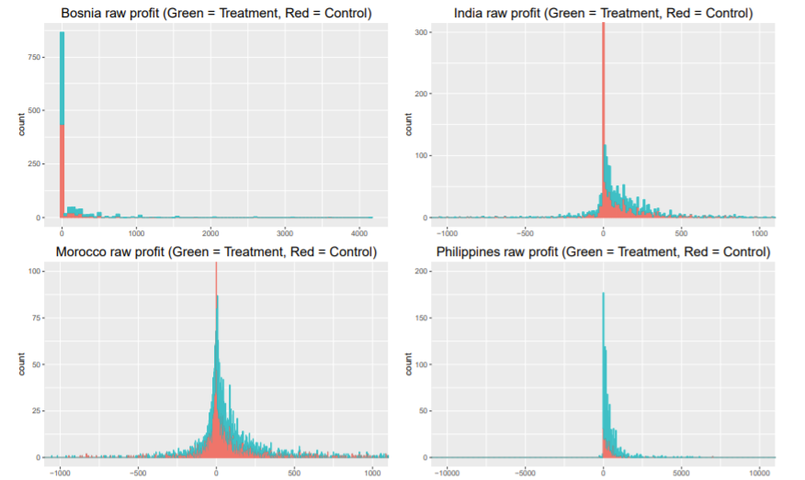
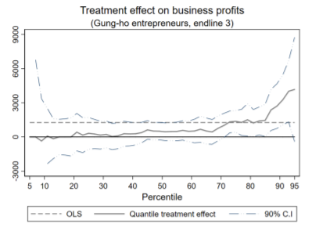
Beyond average effects
Programs and policies don’t only influence means, so we should not only test differences in means
A new rice seed might reduce or increase variance
Some programs might not change median but do change outcomes for a few high performers
Quantile regressions compare outcomes by decile etc
Meager, 2019
Banerjee et al (2019)

Slide 9
Adjusting for clustered randomization

Slide 10
Cluster level analysis
$Y_{ij}$ = α $+ βT_{i}$ $+γ X_{ij }+θ_{j}+ω_{ij}$
$θ_{j}$ is group or cluster level error term, picks up shocks that are common to all those in a group that cannot be explained by treatment status
$ω_{ij}$ is individual error term that picks up any differences from the rest of the sample that cannot be explained by the fact that I is a member of group j or by treatment status or covariates
To do this we need to create a cluster variable which indicates which cluster/group each individual is in, eg if we cluster by village we create a variable that takes a different value for each village (eg village_ID).
In stata we then add a command cluster (school_ID) to our standard individual regression
Clustering must always be done at the level of randomization

Slide 11
Adjusting for clustering when small number of clusters
No single definition for what counts as a small sample, its continuous
But roughly, less than 20 clusters is considered small
Randomization inference is one approach to analysis with small number of clusters
But randomization inference is conservative and does not cope well with stratification
Wild bootstrap procedure (Cameron et al 2008 and Canay et al 2019)
Assumes large number of observations even though number of clusters are small
Can be effective for clusters as few as 5 (with assumptions)

Slide 12
Adjusting for non-compliance

Slide 13
Interpreting ITT in the context of noncompliance
Never drop noncompliers! Or assign based on take up rather than on assignment: only assignment is random
We don’t need to adjust for noncompliance, ITT is a valid estimate
But level of take up is relevant to understanding ITT. Imagine ITT estimate of 0.1SD in two cases
1) 5% of T group took up, 2% in control, difference in take up of 3%
2) 100% of T group took up, 0% in control, difference of 100%
Q: What different conclusions might we draw from these two different cases?

Slide 14
Local Average Treatment Effect, Treatment on the Treated, IV
$$\frac{(mean in treatment −mean in control)}{takeup in treatment −takeup in control}$$
LATE =
We can adjust for low take up (noncompliance) to find the impact of the treatment itself by “scaling up” the impact found through ITT by the difference in takeup between treatment and control
But this is only valid under certain assumptions
Being allocated to treatment has no impact other than through take up of treatment
Eg no spillovers within treatment group
Knowing you were picked for treatment changes your behavior, even if don’t take up
Assignment to treatment does not make someone less likely to take up (no defiers)
Treatment on the treated is LATE when there is no take up in the control (note, sometimes people use it interchangeably with LATE)
Use instrumental variables estimation where treatment assignment is an instrument for take up: as above but allows for control variables

Slide 15
Subgroups and noncompliance
If assumptions to estimate LATE don’t hold, alternative is to estimate ITT but in a subgroup with high take up (eg births vs contraception in BF)
Subgroups can also be useful if we think defiers might be concentrated in certain subgroups
In information treatments useful to separate out effects by those where:
Initial beliefs were higher than true level and information treatment leads to participant to update negatively
Initial beliefs were lower than true level and information treatments leads individual to update positively
Initial beliefs were similar to true level and information treatment leads to no updating

Slide 16
Spillovers

Slide 17
Example: deworming [put in analysis lecture]
If a child is dewormed, they are less likely to infect children in the neighborhood
While most of the spillovers would occur within schools, but some children lived near those who went to neighboring schools
Miguel and Kremer (2004) randomized at the school level but also measured outcomes in near by schools
$Y_{ijt}$ outcome for individual i in school j at time t
$T_{1it}$ treatment dummy for allocation to treatment in first vs second year
$X_{ijt}$ individual and school characteristics
$N_{dit}$number of children in schools within distance d of individual i at time t
$N_{dit}^{T}$number of treated children in schools within distance d of individual i at time t
Note: While number of children living nearby is not random, proportion of them treated is.

Slide 18
Attrition

