Slide 1
The Practicalities of Running Randomized Trials: Lecture 6: Specifying Outcomes with Examples from Health
Rachel Glennerster

Slide 2
Overview
Definitions
Outcomes and theory of change
Measurement and context
standardized measures, or locally tailored?
Admin data vs study specific data
Who makes a good respondent
Timing of data collection
Assessing indicator quality
Tips on health indicators

Slide 3
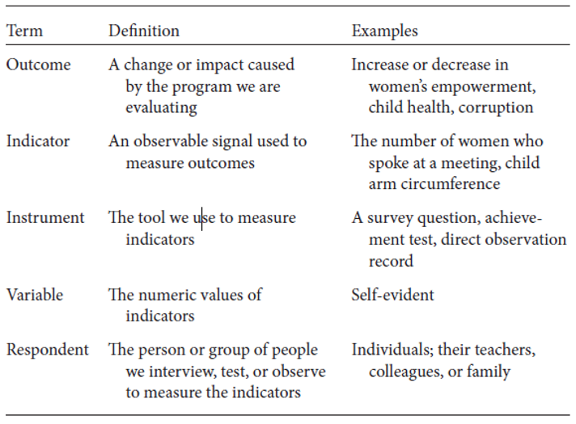

Slide 4
Measurement along a theory of change
What is a theory of change?
Q: Why is it useful?

Slide 5
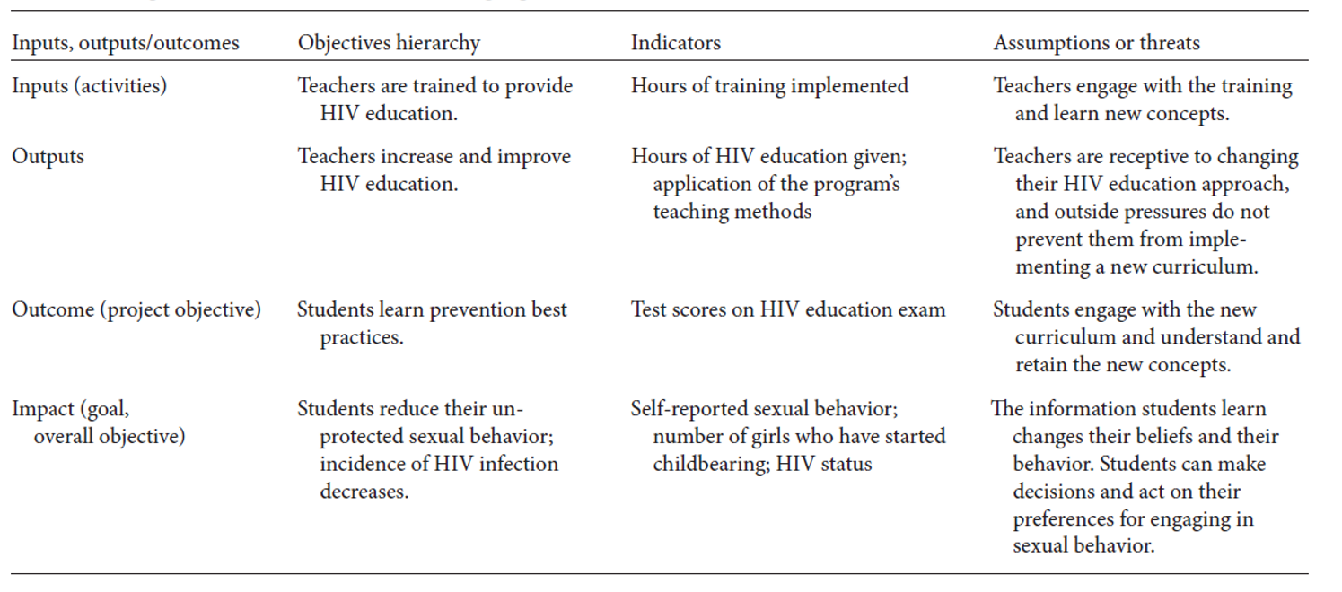
Example: HIV education program

Slide 6
Good measurement requires good understanding of context
What constitutes relevant measure of teacher effort depends on context
Q: what might be some different measures of health worker effort
Some outcomes require more contextual knowledge than others
A lot of (close to) standardized health outcomes like Fully Immunized Child, stunting, wasting, blood pressure etc
We will discuss a lot more about contextualizing measures when we discuss measuring social capital

Slide 7
Pros and cons of relying on measures common in the literature
Health has many standardized measures
Modern contraception prevalence rate specifies which contraceptive methods are considered modern
Specified cut offs for stunting, obesity etc
Standard questions to categorize mental health
Q: what are the benefits of using a measure that is common in the literature?
Q: what are the downsides of using measures common in the literature?
Usually best to use both widely used and some specifically tailored outcome measures

Slide 8
Admin data vs study specific data collection
Q: What are the benefits of admin data?
Larger sample size
Cheaper
History of preintervention data
Useful to do validation of admin data with own checks to see if useable
Q: What are the benefits of study specific data?
Less subject to reporting bias
If action is taken on the basis of admin data, very likely to be biased
Look precisely at the outcome of interest
Richer understanding of mechanisms (eg not just contraception distribution but reports of norms, perceptions of side-effects etc)
Ability to get creative

Slide 9
Who makes a good respondent
Well informed about the behaviour/outcome we care about
Q: can anyone think of an example where they might be a mismatch between who is asked and who has the information?
Efficient source of information
Eg asking school mates who dropped out because of pregnancy (Dupas)
Can be reached relatively easily, has time to answer questions
Does not have an incentive to misreport
Q: What are examples of incentive to misreport?
Q: What is social desirability bias

Slide 10
Timing of data collection
The best time of day to conduct surveys depends on where and who you are interviewing
Women with young children often middle of the day
Men and women working outside the home, must be early or late
Think about right time of year
Roads impassible? people busy with harvest? Children back home or everyone traveling?
Q: When should you consider NOT doing a baseline?
When sample size is limited by budget only—ie could double sample without a baseline
When you don’t need to prove balance at start with baseline (eg other data, clear its random)
You have other data to stratify on
Q: When should you collect data for more than 2 time periods?

Slide 11
Assessing indicator quality
Logically valid: logical link between outcome of interest and indicator we measure
Is HIV status a logically valid indicator of safe sex
Is HIV status a logically valid indicator of knowledge of safe sex?
How might a program change the relationship between an outcome and an indicator?
Measurable
Observable
Feasible
Detectable: Q: what would be an undetectable indicator? Precision: exhaustive vs exclusive (see figure)
Reliable (eg social desirability bias)
Make sure data is being collected in the same way in T and C, same incentives to report truthfully in T and C

Slide 12
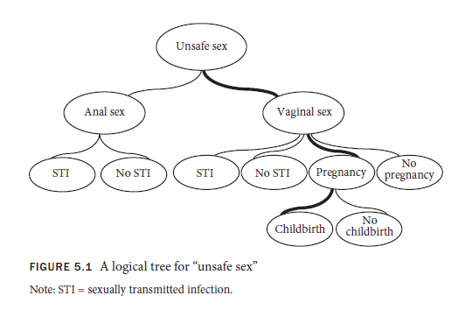
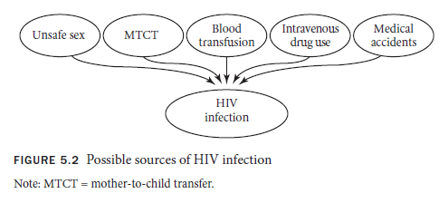
Exhaustive vs exclusive indicators: Q: which is which?

Slide 13
Tips on health indicators
There are a lot of well validated standardized health indicators. Still need to pick the right one
Nutrition: stunting is measure of long-term malnutrition, wasting is more short term.
Immunization: BCG/Penta 1 for ever immunized, FIC measure of persistence
Particularly useful to use some of these standard indicators in health because health does a lot of meta-analyses which pool effect sizes. Risk being left out of these with nonstandard indicators
Demographic and household Surveys (DHS) is useful source of good questions: standardized but also validated in many countries.
Add more tailored indicators for intermediate outcomes tied to specific intervention theory of change
Behavior change: using contraception, uncontaminated water, easier to pick up than final outcomes (eg child mortality, births) as these are rarer events. But they are more subject to reporting bias.
There are fewer standardized measures of health worker behavior: recent innovations by economists
Jishnu Das has done innovative work in this space

Slide 14
Slides left from lecture 5

Slide 15
Basic requirements for IRB
All personnel on the project are human-subjects certified
Includes RAs in field and those handling identified data
Enumerators trained in appropriate interactions and data handling
National Institutes of Health has online training program
Research design including all surveys reviewed and approved
Precise wording of consent forms and whether consent is oral or written needs to be reviewed and approved
Data management plan is approved and complied with
Annual updates are usually required which include status of research and number of human subjects reached
Any breach in IRB compliance is reported to IRB committee

Slide 16
Personally identified information
Information that can be used to identify an individual or households with a reasonable level of confidence. Includes:
Names
Geographical information like village name or GPS coordinates
Telephone numbers/ Email addresses/ addresses
Account numbers
Certificate or license numbers
Full face photos
Government identification numbers
Combination of information (like village name and occupation) may identify someone, even when one on its own will not.
Note US health data has specific rules on data confidentiality under HIPPA

Slide 17
Data management plans
Paper surveys
Include method of recording consent on all surveys (good practice to include precise consent language on all surveys too)
Design questionnaire so that PII can be easily and quickly removable (eg have PII on first sheet with an ID number on every page of the survey then the first page can be manually removed by supervisors in the field for identification)
Secure storage and disposal of surveys
Data in digital form
Encryption for all data with PII, including data collection software and data entry software
Use encryption software for all devises using data, including servers and computers
Separate PII from non-PII for easier data management

Slide 18
Timing of approval
Exploratory work may not count as “research”
Still useful to get general approval at early conceptual stage as work starts to become more systematic over time, with larger scale piloting.
Before full scale study starts provide research design, detailed surveys and final number of subjects to IRB for approval.
Don’t start before it is approved!
Approvals usually need to be updated every year with updates of people reached and any adverse consequences
Exemptions: if study has very low risk of harm an exemption can be applied for
When risk is low, expedited review may be requested

Slide 19
Checklist for IRB compliance
All project staff have take IRB course and sent certifications*
Survey structured with PII-Consent detachable from questionnaire
Field staff sign a confidentiality agreement before working with data/surveys*
Using IRB approved consent form*
Unique ID code written on every page*
PII-Consent separated from questionnaire prior to data entry
Hard copies stored in a secure location*

Slide 20
IRB checklist continued
Use encryption for storage, transmission and access of PII data*
Make 2 backup copies (encrypted) of the original data*
Store backup copies on a secured server
Confirm data entry operators have removed data from their computers*
Separate PII from non-PII whenever possible

Slide 21
Check local IRB rules
Rules and interpretation of rules for IRB vary widely by institution, country, and field
The information given here is illustrative
It is important to check the detailed rules in in the institution to which an individual researcher is based and the country in which a study is being carried out

Slide 22
Improving learning in India
Pratham is a large Indian education NGO
“every child in school….and learning well”
Successful urban program, new program for rural areas
Developed tool to test learning, community members generated village score cards
Facilitated village meeting where information on ways to improve education were shared, eg VEC
Trained volunteers to run after school reading camps

Slide 23
Research design
Randomized at village level
65 villages received information on how to improve education
65 received information and scorecards
65 received information, scorecards, and reading camps
85 in comparison group
Data collected on:
Children’s learning levels
Teacher absenteeism
Parents preferences and actions in promoting education
Village Education Committee members knowledge and actions

Slide 24
Who is the subject of the research?
All households? Children? Teachers? Village leaders? Those interviewed?
All impacted by the intervention, are they all impacted by research?
Indirect effects of any action can far reaching
Do we need to get permission of one shopkeeper before giving a loan to a neighboring shop keeper who might cut into their market?
Informed consent for what?
To be interviewed?
To have data collected on them? (eg teacher absenteeism)
To allow intervention to go ahead? (ie veto power)

Slide 25
What is research and what is practice?
Practice: Pratham regulated as an NGO in India
Right and ability to implement their program without informed consent of everyone in the village
Eg can provide information about villager rights without teacher or village leader giving their consent, though leader might be impacted
Pratham worked closely with researchers to design the program (drawing on their knowledge of what works), does that make it research?
Research: Systematic study leading to general lessons
Bad studies aren’t regulated, good ones are?
Changes made to implementation in order to evaluate (none)
Data collection storage and analysis (informed consent needed)

Slide 26
Possible criteria for regulating CRTs
Regulations for answering these questions are surprisingly underdeveloped. The following are some suggested criteria
Would the intervention have happened anyway? What change is due to the evaluation?
Subjects are those impacted by changes due to evaluation
Is participation in the intervention voluntary?
More careful assessment and consent rules for involuntary programs
Some deference to local standards and regulations
Eg right of community to collect information on absent teachers
Level of risk and benefit
Parent may punish their child if they find out they are performing badly
But benefit from study in improving education

