Slide 1
Advantages and limitations of non- and quasi-experimental methods
Module 2.2

Slide 2
Overview
Qualitative
Pre and post
Cross sectional
Multivariate regression
Multivariate regression, matching
Difference-in-difference
Regression discontinuity
Instrumental variable

Slide 3
Qualitative
Description and assessment not boiled down into numbers
Advantages
More detail and nuance than quantitative evaluations
Questions are open ended, flexibility to respond to pathways of impact not anticipated prior to study start
Can generate new hypotheses of impact pathways
Assumptions required for assessing impact
Respondent or researcher knows the counterfactual, eg by comparing with life prior to program or to nonparticipants and reveal it truthfully
More research judgment in aggregating or highlighting responses. Need stronger assumptions about no researcher bias. Are nonrepresentative but interesting individuals given more weight?

Slide 4
Pre vs. post comparisons
Comparison of outcomes before and after the start of the program
Who is the comparison group?
Participants prior to the start of the program
Advantages
Relatively simple
Assumptions required
No changes in the environment or individuals over time not related to the program
Participants did not sign up because of a shock, eg they just lost their job

Slide 5
Cross section comparisons
Comparisons across individuals at the same time
Who makes up the comparison group?
Nonparticipants
Advantages
Can be undertaken after the program has started
Required assumption
Participants are not different from nonparticipants in any way except as a result of the program, including in the potential for future change

Slide 6
Multivariate regression
Comparison between participants and nonparticipants in which observable differences are controlled for
Who makes up the comparison group?
Nonparticipants with the same measured outcomes at program start
Advantages
Adjusts for some of the differences between participants and nonparticipants
Required assumption
The only differences between participants and nonparticipants are those we have data on

Slide 7
Multivariate regression: matching
A form of multivariate regression where participants are placed in categories and “matched” with nonparticipants with the same characteristics
Who makes up the comparison group?
Option 1: nonparticipants who have the option to take up the program but dont take up and have the same observable characteristics
Option 2: nonparticipants that did not have the chance to take up and have similar attributes to those who take up

Slide 8
Matching example
$
Poor woman
$
$
Poor man
$
$
Rich woman
$
$
$
Rich man
$
$
Takes up program
District 1: program offered
District 2: no program
Not everyone takes up the program

Slide 9
Matching: option 1
$
Poor woman
$
$
Poor man
$
$
Rich woman
$
$
$
Rich man
$
$
Takes up program
District 1: program offered
District 2: no program
Comparison group: those with similar characteristics who don’t take up
Q: why might those who don’t take up be different?

Slide 10
Matching: option 2
$
Poor woman
$
$
Poor man
$
$
Rich woman
$
$
$
Rich man
$
$
Takes up program
District 1: program offered
District 2: no program
Compare those who take up the program with those with similar characteristics who don’t have access to the program
Q: what might be different between poor woman in district 1 vs district 2?

Slide 11
Multivariate regression: matching
Advantages
Many econometricians consider matching worse than standard multivariate regression as the assumptions are less transparent
Required assumptions
Option 1: the only reason one person took up and a matched individual didn’t is chance
Option 2: any difference between the areas where the program is and is not operating is the difference in the number of people with given characteristics
E.g. the poor in program areas are the same as the poor in nonprogram areas

Slide 12
Difference-in-difference
Compares changes over time between participants and nonparticipants
Who makes up the comparison group?
Nonparticipants, but we compare changes (rather than levels) for participants and nonparticipants
Advantages
The approach takes into account general changes over time that are common to both participants and non participants
We do not need to assume that we have measured all differences between participants and nonparticipants
Required assumption
The only differences between participants and nonparticipants are in the levels of observed and unobserved outcomes at the start
There is no difference in the potential for change, or starting growth rates between participants and nonparticipants

Slide 13
Regression discontinuity
Comparison between those who are just eligible and just ineligible to participate in a program
Who makes up the comparison group?
Those who just miss an eligibility cut off
Advantages
Participation is determined by a rule (not self section)
We can adjust for those characteristics we know determine participation
Those just above and below the cut off will be very similar even on these characteristics

Slide 14
Regression discontinuity II
Required assumptions
The program eligibility is administered exactly according to the rules
Measurement of criteria used in the cut off is not manipulated to get some people into the program
There is nothing else that suddenly changes just at the cut off point
There are a large number of people just above and below the cut off

Slide 15
RDD: Value of intensive care
Children born with low birth weight in the US are put into intensive care
Intensive care is expensive, but how much does it help low birth weight children?
Many doctors use a weight cutoff of 1,500 grams to determine if a child needs intensive care
Risk of dying declines as weight goes up but those just above and below the cutoff should be similar
Except that those below get intensive care
Almond et al (2010) use this to estimate the benefit of intensive care

Slide 16
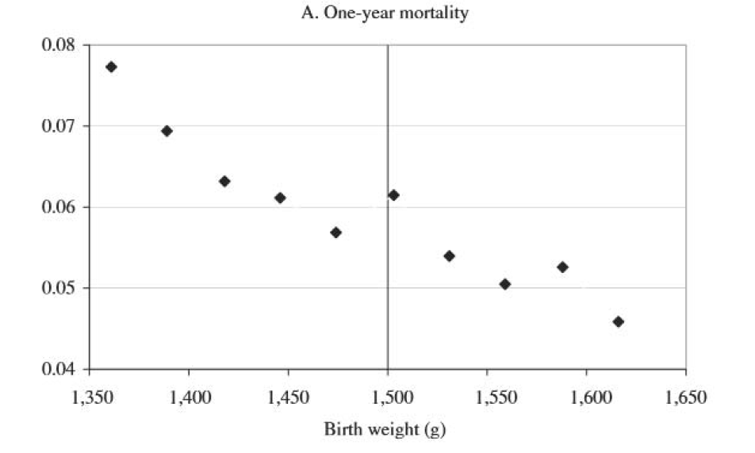
RDD: Value of intensive care
Source: Almond, Doyle, Kowalski, and Williams, 2010.

Slide 17
Instrumental variables
Uses a random variable (the instrument) to predict program take up
Who makes up the comparison group?
Those predicted not to take up by the instrument
Advantages
The right instrument can deal with selection bias
Required assumptions
The instrument predicts take up
The instrument does not predict anything else that could effect outcomes, i.e. there is no selection in the instrument, and the instrument impacts take up but nothing else relevant to the outcome

Slide 18
Example: instrumental variables
What is the impact of access to TV on social capital?
TV reception in villages along a valley varies by height of mountain ridge separating valley from large town with TV tower
Instrument: height of ridge
Assumptions
Height of ridge is correlated with use of TV
Height of ridge is not correlated with travel time to town
Height or ridge is not correlated with farming conditions in the village, hence income
Source: Olken, 2009

