Slide 1
The Practicalities of Running Randomized Trials:
Lecture 9: Sample Size and Power
Rachel Glennerster

Slide 2
Outline
Introduction to power
Hypothesis testing
Ingredients of power
Power with clusters (if time)

Slide 3
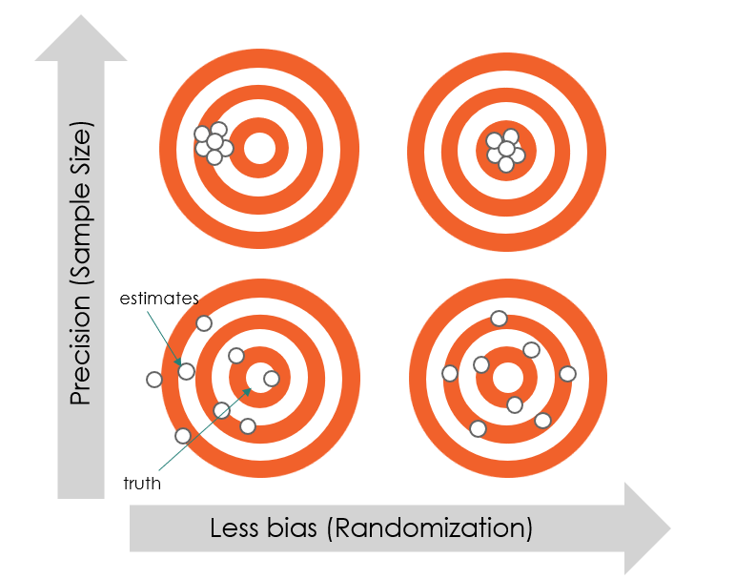
Precision vs Bias: Power is About Precision

Slide 4
Introduction

Slide 5
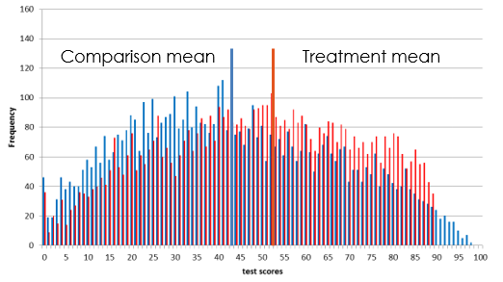
When we analyze and RCT we compare mean of treatment and control

Slide 6
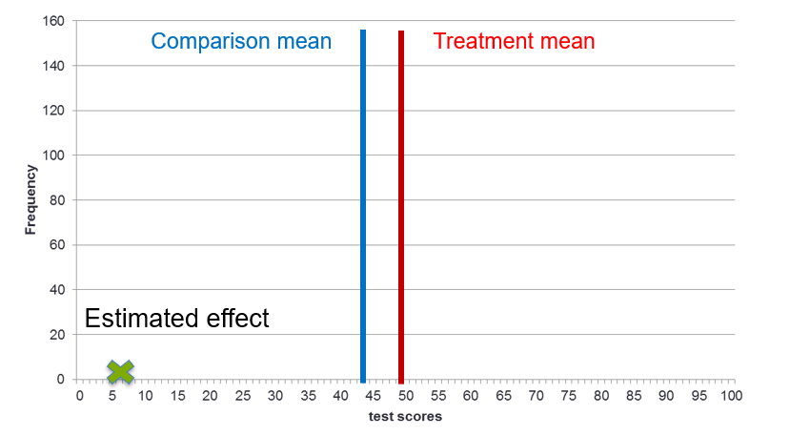
The difference between the means gives us our estimated effect

Slide 7
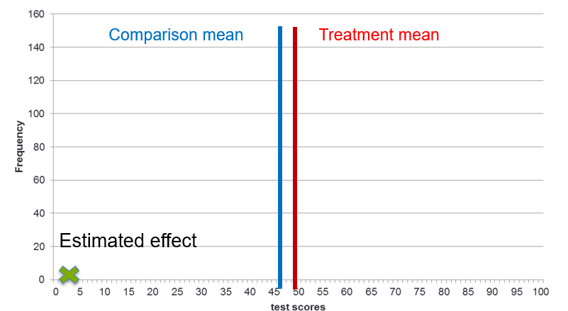
What if we ran a second experiment

Slide 8
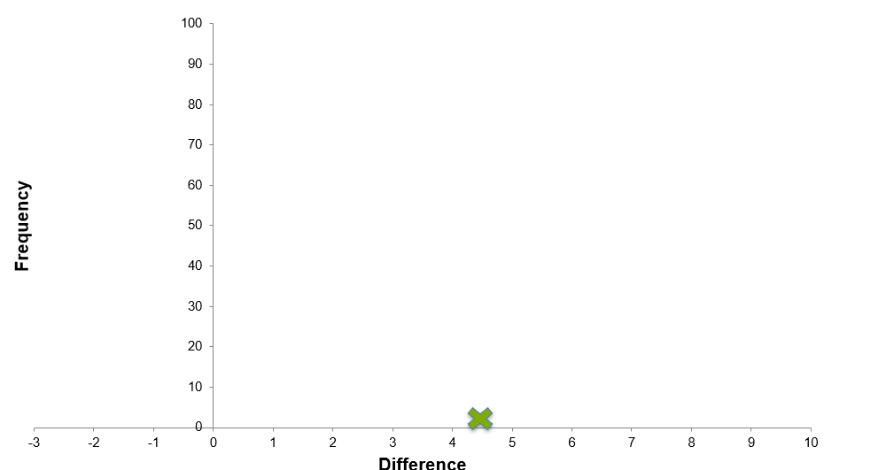
Running many experiments gives us a distribution of effect sizes

Slide 9
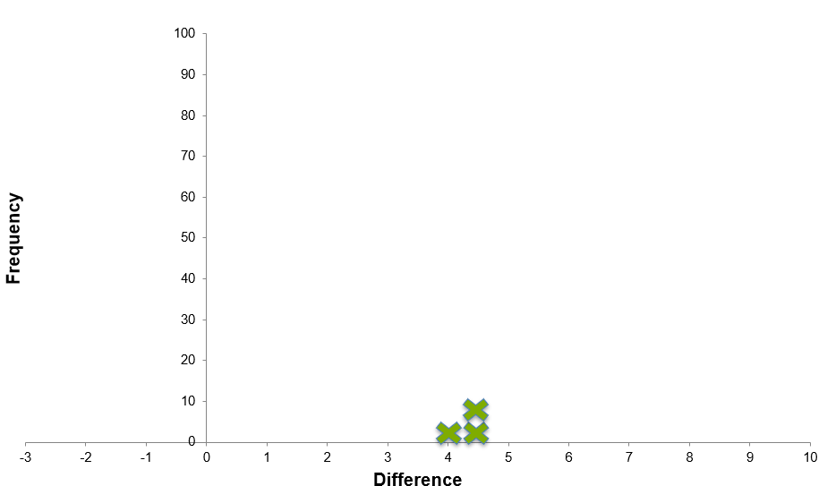
Running many experiments gives us a distribution of effect sizes

Slide 10
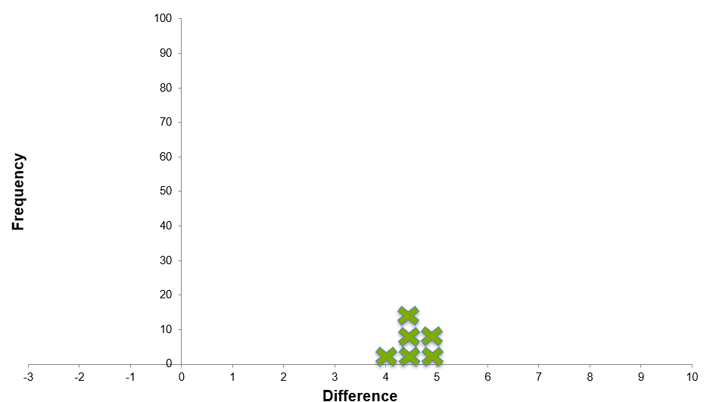
Running many experiments gives us a distribution of effect sizes

Slide 11
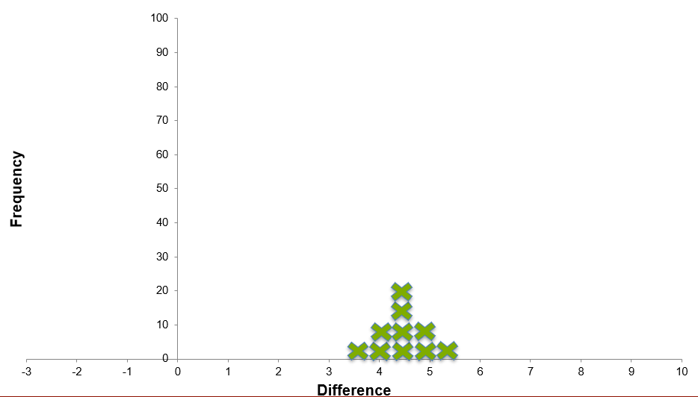
Running many experiments gives us a distribution of effect sizes

Slide 12
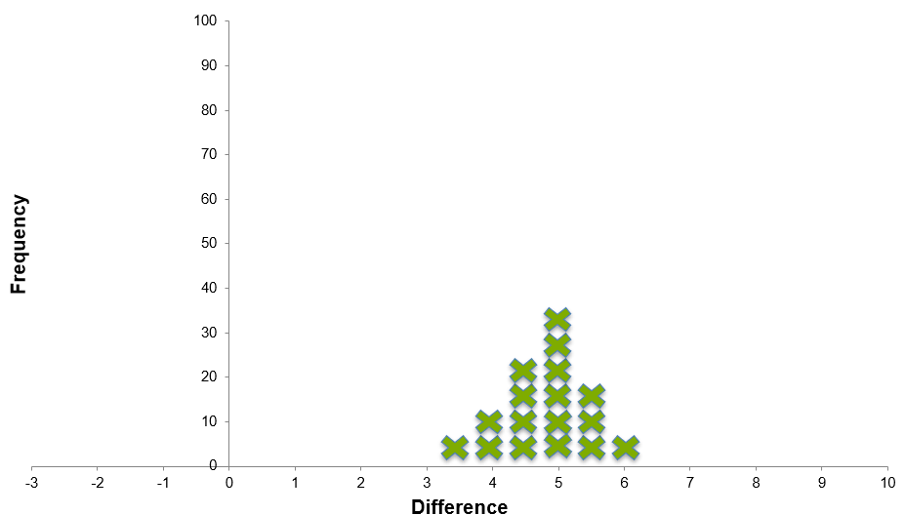
Running many experiments gives us a distribution of effect sizes

Slide 13
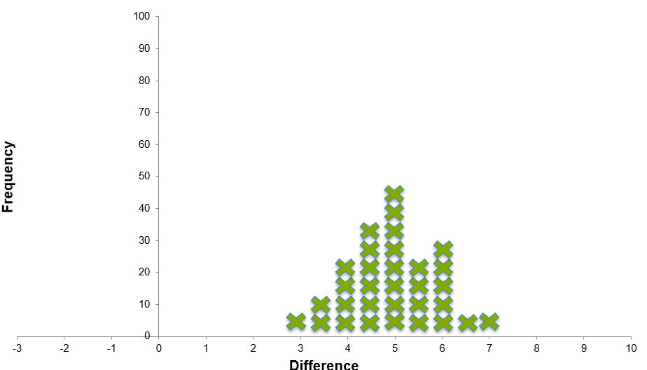
Running many experiments gives us a distribution of effect sizes

Slide 14
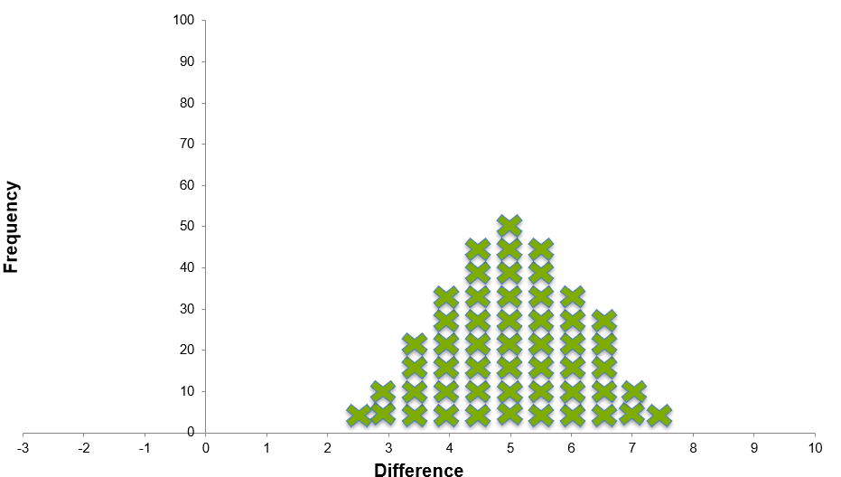
Running many experiments gives us a distribution of effect sizes

Slide 15
Hypothesis testing

Slide 16
Distribution of estimates if true effect=β
_{β}
Estimated effects normally distributed around effect β

Slide 17
Distribution of estimates if true effect=0
₀
Estimated effects normally distributed around effect 0

Slide 18
Two distributions under two hypotheses
H₀
H_{β}
Probability of getting a given estimate under two hypotheses

Slide 19


If we run one study, see one estimate $\hat{β}$
$$\hat{β}$$
How do we know if our estimated effect is significant?

Slide 20

Did our estimate come from $H_{β} or$ $H_{0}$?
True effect=H₀
H_{β}
True effect=H_{β}
H₀
P1
P2
Which is more likely?
Can we rule out that the estimate comes from H₀?

Slide 21
Impose significance level of 5%
Critical value
Critical value
H₀
H_{β}
True effect=H₀
True effect=H_{β}
Anything between lines cannot be distinguished from 0

Slide 22
Critical Value
Definition: The estimated effect size that exactly corresponds to the significance level.
If testing whether:
  The effect is bigger than 0
  Significant at 95% level
  Then, critical value is the level of the estimate where exactly 5% of area under the curve lies to the right

Slide 23

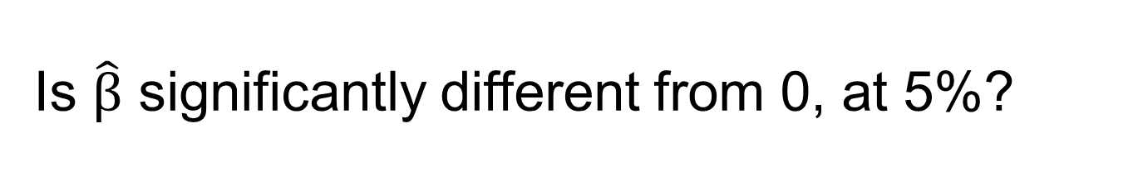
Is $\hat{β}$ significantly different from 0, at 5%?
$$\hat{β}$$
H₀
H_{β}
How do we know?

Slide 24
Hypothesis testing
Usually in RCTs, we have a “presumption of zero”
The “Null hypothesis” (H₀) is then that there was no (zero) impact of the program
The burden of proof is on showing there was an impact
Note, there are exceptions:
  e.g. the null for a cash plus training program might be that it’s the same as the training on its own

Slide 25
Hypothesis testing
If it is very unlikely (less than a 5% probability) that the difference is solely due to chance:
  We “reject our null hypothesis”
We may now say:
  “our program has a statistically significant impact”
What is statistically significant and what is most likely are different concepts
  there may be cases where it’s more likely that the program worked than that it didn’t, but we still say there is no statistically significant impact

Slide 26
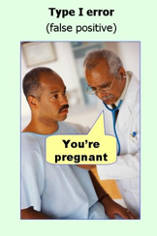
Significance and Type I Errors
Traditionally significance level is set at 5%
This means allowing a 5% chance of experiencing Type I errors
5% of time we will say program had impact when in fact it didn’t

Slide 27
If true effect was β
Critical value
Critical value
H₀
H_{β}
True effect=H₀
True effect=H_{β}
How often would we get an estimated effect we can distinguish from zero?

Slide 28
How often would we reject null, if Hβ true?
True effect=H₀
True effect=H_{β}
Power
H₀
H_{β}
Shaded area shows power = % of time we would find Hβ different from 0 if true effect was β

Slide 29
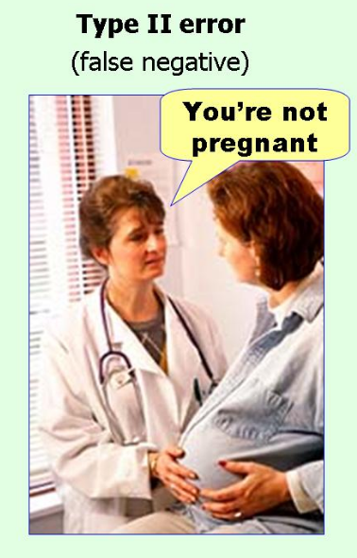
Power to Avoid Type II Errors
Statistical power is the probability that, if the true effect is of a given size, our proposed experiment will be able to distinguish the estimated effect from zero
Power is the probability of avoiding Type II errors
Traditionally, we aim for 80% power (some aim for 90%)
Low power means we may not find a significant effect even though an effect exists

Slide 30


Four Results From Hypothesis Testing
Underlying truth
Effect
No effect
No error
Power: when there is effect
Prob we find significance
Significant
Statistical test
No error
Not significant

Slide 31
Four Results from Hypothesis Testing

Slide 32
What influences power?
True effect=H₀
True effect=H_{β}
Power
H₀
H_{β}
Move overlap of curves, less power, what influences overlap of these curves?

Slide 33
Power: main ingredients
Effect size

Slide 34
Effect Size: 1*SE
1 Standard Error
H₀
H_{β}
True effect=H₀
True effect=H_{β}

Slide 35
Effect Size = 1*SE
True effect=H₀
True effect=H_{β}
H₀
H_{β}
Significance

Slide 36
Power: 26%
If the true impact was 1*SE…
True effect=H₀
True effect=H_{β}
H₀
H_{β}
Power
The Null Hypothesis would be rejected only 26% of the time

Slide 37
Effect Size: 3*SE
3*SE
H₀
H_{β}
True effect=H₀
True effect=H_{β}
Bigger hypothesized effect size → distributions farther apart

Slide 38
Effect size 3*SE: Power= 91%
True effect=H₀
True effect=H_{β}
H₀
H_{β}
Power
Bigger Effect size means more power

Slide 39
Effect Size and Take-Up
Let’s say we believe the impact on our participants is “3”
What happens if take up is 1/3?
Let’s show this graphically

Slide 40
Effect Size: 3*SE
3*SE
H₀
H_{β}
True effect=H₀
True effect=H_{β}
Let’s say we believe the impact on our participants is “3”

Slide 41
Take up is 33%. Effect size as measured on T group is 1/3rd
1 Standard Error
True effect=H₀
H₀
H_{β}
True effect=H_{β}

Slide 42
Back to: Power = 26%
True effect=H₀
True effect=H_{β}
H₀
H_{β}
Power
Take-up is reflected in the effect size

Slide 43
Power: main ingredients
Effect size
Sample size

Slide 44
Power: Effect size = 1 SE
Sample size = 1,000
H₀
H_{β}
True effect=H₀
True effect=H_{β}
Significance
Notes:
ADD NUMBER FOR N

Slide 45
Power: Effect size= 1SE
Sample size = 4,000
H₀
H_{β}
True effect=H₀
True effect=H_{β}
Significance

Slide 46
Power: 64%
H₀
H_{β}
True effect=H₀
True effect=H_{β}
Power

Slide 47
Power: Sample size = 9,000
H₀
H_{β}
True effect=H₀
True effect=H_{β}
Significance

Slide 48
Power: 91%
H₀
H_{β}
True effect=H₀
True effect=H_{β}
Power

Slide 49
Power: main ingredients
Effect size
Sample size
Variance

Slide 50
Low variance sample
H₀
H_{β}
True effect=H₀
True effect=H_{β}
Significance
Estimates will be more tightly clustered

Slide 51
Low variance sample
H₀
H_{β}
True effect=H₀
True effect=H_{β}
Power
Estimates will be more tightly clustered ➔ Higher power

Slide 52
Higher variance sample
True effect=H₀
True effect=H_{β}
Significance
H₀
H_{β}
Estimates will be more dispersed

Slide 53
Higher variance sample
True effect=H₀
True effect=H_{β}
H₀
H_{β}
Power
Estimates will be more dispersed ➔ Lower power

Slide 54

Variance and power: intuition
Our program seeks to increase child height
There is a lot of variation in height in the population
At endline children in treatment are taller than in control
Is this because we happened to start with taller children? or because the program worked?
We need a big sample to sort this out
Population
Treatment
Control

Slide 55
Variance and power: intuition
If everyone in the underlying population was of similar height at the start, it would be easy to sort this out
  we would need a smaller sample (or have more power with a given sample)
  the variation we see at the end between treatment and control must be due to the program
Population
Control
Treatment

Slide 56
Power: main ingredients
Effect size
Sample size
Variance
Proportion of sample in different randomization cells

Slide 57
Sample split: 50% C, 50% T
H₀
H_{β}
True effect=H₀
True effect=H_{β}
Significance
Equal split gives distributions that are the same “fatness”

Slide 58
Power: 91%
H₀
H_{β}
True effect=H₀
True effect=H_{β}
Power

Slide 59
What if its not 50:50 split?
What happens to the relative fatness if the split is not 50:50.
Say 25-75?

Slide 60
Sample split: 25% C, 75% T
H₀
H_{β}
True effect=H₀
True effect=H_{β}
Significance
Uneven distributions, not efficient, i.e. less power

Slide 61
Power: 83%
H₀
H_{β}
True effect=H₀
True effect=H_{β}
Power

Slide 62
Allocation ratio
Definition: the fraction of the total sample allocated to the treatment group is the allocation ratio
Usually, for a given sample size, power is maximized when half sample allocated to treatment, half to control
Diminishing marginal benefit to precision from adding sample, so best to add equally

Slide 63
Allocation to T v C

Slide 64
Power equation: MDE
Significance
Level
Variance
Effect Size
Power
Sample
Size
Proportion in
Treatment

Slide 65
Power with clustered RCT designs

Slide 66
Power with clustered design: intuition
You want to know how close the upcoming national elections will be
Method 1: Randomly select 50 people from entire US population
Method 2: Randomly select 10 families, and ask five members of each family their opinion

Slide 67




Low intra-cluster correlation (ICC) or ρ (rho)
Population
Control
Treatment
Notes:
NOTE: Changing all of your icons at the moment is not necessary, but when you create new graphics we highly recommend flat icons as seen in the example above. www.thenounproject.com is a great resource for free vector and/or jpg icons when you need them.

Slide 68
HIGH intra-cluster correlation (ρ)
Population
Control
Treatment
Notes:
DESIGN TEAM

Slide 69
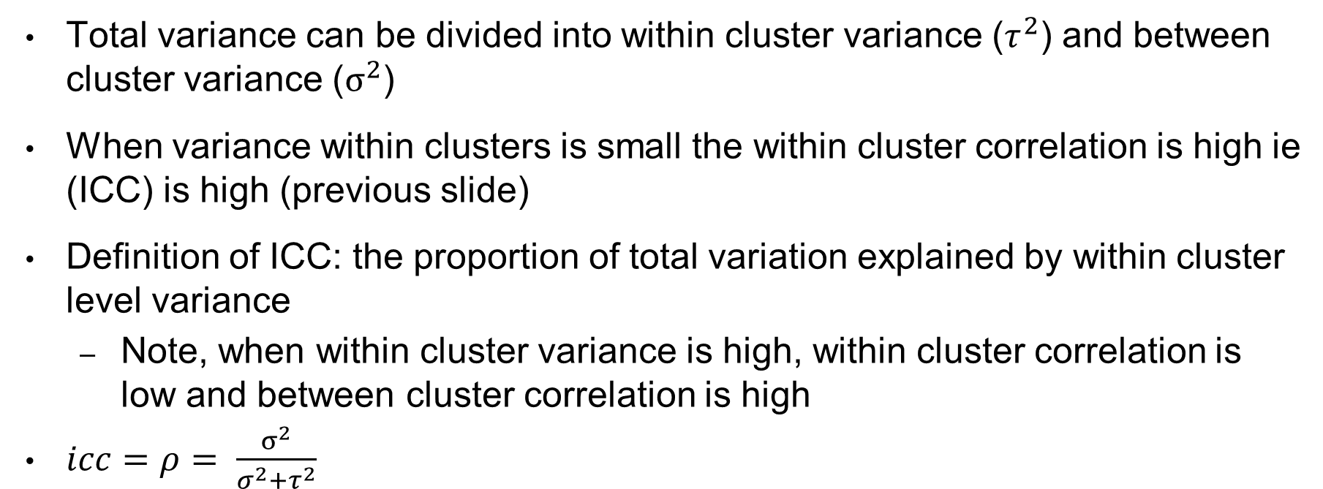
Intra Cluster Correlation Definition
Total variance can be divided into within cluster variance ($τ^{2}$) and between cluster variance ($σ^{2}$)
When variance within clusters is small the within cluster correlation is high ie (ICC) is high (previous slide)
Definition of ICC: the proportion of total variation explained by within cluster level variance
  Note, when within cluster variance is high, within cluster correlation is low and between cluster correlation is high
$icc=ρ= \frac{σ^{2}}{σ^{2}+τ^{2}}$

Slide 70
How does ICC impact power?
For a given N we have less power when we randomize by cluster (unless ICC is zero)
There are diminishing returns to surveying more people per cluster
Usually, the number of clusters is a bigger determinant of power than the number of people per cluster

Slide 71
When do we get high/low ICC?
All people with no education live in one village. People with only primary education live in another. College grads live in a third, etc. ICC (ρ) on education will be..
High
Low
No effect on rho

Slide 72
What do we do if we have high ICC
If ICC (ρ) is high, what is a more efficient way of increasing power?
Include more clusters in the sample
Interview more people in each cluster
Both

Slide 73
Power with clustering
Significance
Level
Variance
Effect Size
Power
Proportion in
Treatment
ICC
Average
Cluster Size
Sample
Size

